Slide 1

Lesson Seven Waste from Nuclear Power Plants
The Harnessed Atom

Slide 2
What you need to know about Nuclear Power Plant Waste:
Nuclear Waste
Some radioactive
Types of radioactive waste
Low-level waste
High-level waste
Disposal and storage
Low-level waste disposal
Spent fuel storage
Waste isolation
Reprocessing
Decommissioning

Slide 3
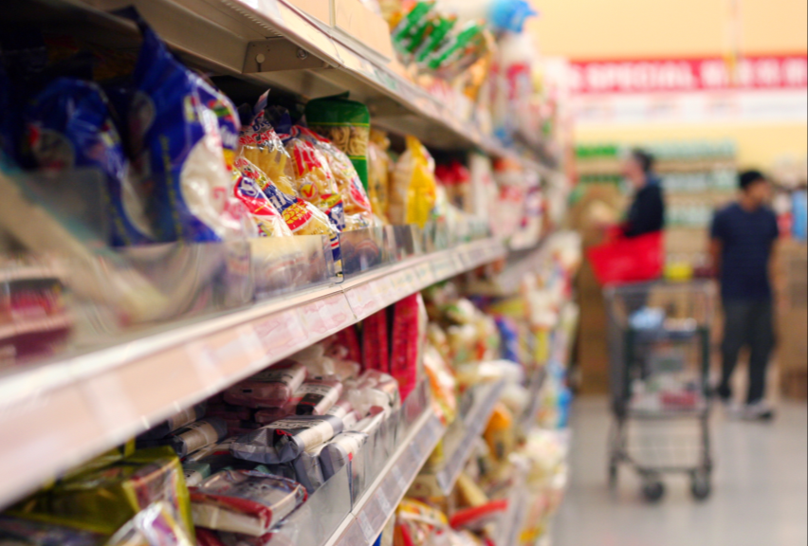
Everyday we all produce waste.
Think of your family’s grocery list.
We buy a lot of stuff.
Then we throw away or recycle whatever we don’t use.
That’s a lot of waste.
Some of the waste we generate can go to a landfill. Other wastes must be disposed of more carefully

Slide 4
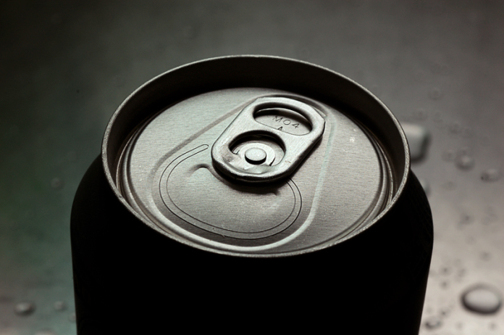
Nuclear power plants produce waste, too.
Like all industries, power plants produce waste.
A typical nuclear power plant produces about 30 tons of used fuel per year. We call it spent fuel.
A similar sized coal-fired power plant produces 300,000 tons of coal ash per year.
“If all the electricity you
used in your lifetime was
nuclear, the amount of
waste that would be added
up would fit in a soda can.”
—Stewart Brand, environmentalist
Notes:
Ounce for ounce, coal ash released from a power plant delivers more radiation than nuclear waste in water or dry cask storage. In fact the ash from burning coal at a power plant emits 100 times more radiation into the surrounding environment than a nuclear power plant producing the same amount of energy. Our sources for this statistic are Scientific American “Coal Ash is More Radioactive than Nuclear Waste: By burning away all the pesky carbon and other impurities, coal power plants produce heaps of radiation” December 13, 2007 (http://www.scientificamerican.com/article.cfm?id=coal-ash-is-more-radioactive-than-nuclear-waste); Dana Christensen, an associate lab director for energy and engineering at Oak Ridge National Laboratory; Science, 1978 J.P. McBride and colleagues, ORNL.
Numbers on slide from http://www.nei.org/resourcesandstats/nuclear_statistics/nuclearwasteamountsandonsitestorage/

Slide 5
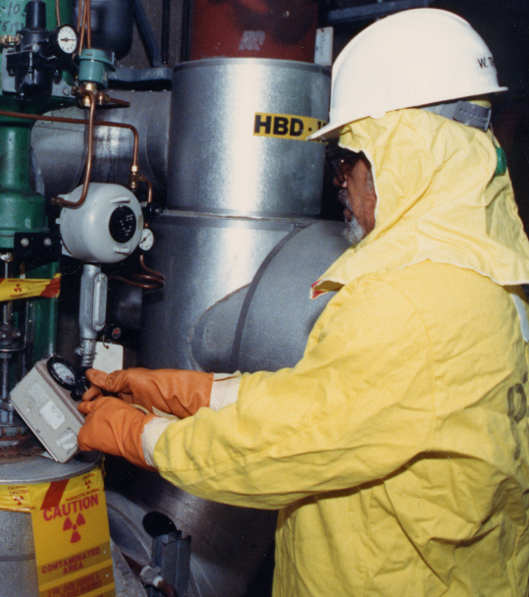
Nuclear power plant waste needs special care.
Some nuclear power plant wastes are radioactive.
Disposing of nuclear waste requires special care to protect workers, the public, and the environment.
One of the main concerns about nuclear power plants is choosing how to dispose of spent fuel.
Notes:
This worker is taking a reading of the radioactivity present on the surface of a nuclear power plant’s machinery. His protective clothing will become low-level waste.

Slide 6
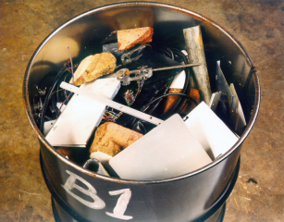
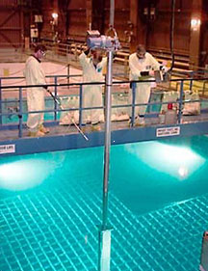
Types of waste from nuclear power plants
Radioactive waste can be either low-level waste or high-level waste. Both are contaminated with radioactive materials.
Low-level waste
High-level waste
Gloves and protective clothing
Cleaning supplies, filters
Laboratory supplies
Broken tools
Spent (used) fuel
Waste left from reprocessing

Slide 7
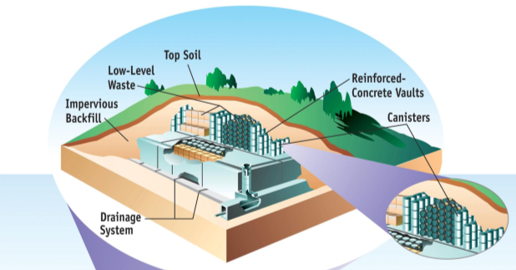
How we dispose of low-level waste
Low-level waste is usually packed in boxes or drums and shipped to disposal sites where it is
Buried in trenches
Covered with soil and a cap that sheds water and
Monitored to detect radiation.
Notes:
This graphic of a low-level waste facility is from the Nuclear Regulatory Commission.

Slide 8
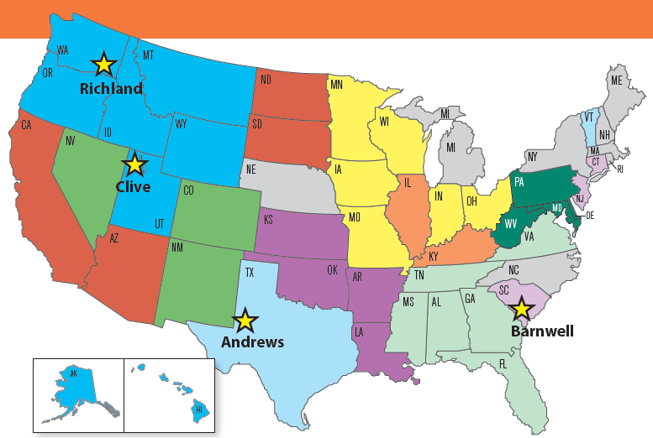
Where are low-level waste disposal sites?
Each state is responsible for disposing of its low-level waste. Most States formed compacts with other States because 50 sites are not needed.
Four low-level waste disposal facilities are in
Richland, WA
Clive, UT
Barnwell, SC
Andrews, TX
Notes:
Each state is responsible for disposal of the low-level waste from utilities, industries, hospitals, and research institutions within its borders. Some states have joined together to form low-level waste compacts. This map shows the 10 compacts of 40 states. Ten states (in gray in the map above) have decided not to join a compact.
States are also responsible for disposal of low-level wastes from federal government facilities like veterans’ hospitals or non-weapons related government facilities. The federal government is responsible for disposal of low-level waste generated by the Department of Energy, including wastes from the atomic weapons program and from the decommissioning of nuclear reactors which power naval vessels.

Slide 9

How to dispose of high-level waste
Every 18-24 months, about one third of the fuel assemblies at a nuclear plant are replaced with new ones. Fuel that has been removed from the reactor is called spent fuel.
Spent fuel is still very hot — thermally and radioactively.
It is stored in a deep, steel-lined concrete pool called the spent fuel pool at the power plant site.
Notes:
Spent fuel pools are storage pools for spent fuel from nuclear reactors. They are typically 12 meters (40 feet) or more feet deep, with the bottom equipped with storage racks designed to hold fuel assemblies upright. The water cools the fuel and provides shielding from radiation.

Slide 10
What happens in the spent fuel pool?
The water in the spent fuel pool cools the fuel and provides shielding from radiation. During storage, spent fuel becomes less radioactive through radioactive decay.
3 months
loses 50% of its radioactivity
1 year
loses 80% of its radioactivity
10 years
loses 90% of its radioactivity
thousands of years
is still radioactive
Spent fuel must be isolated from people and the environment for about 10,000 years.

Slide 11
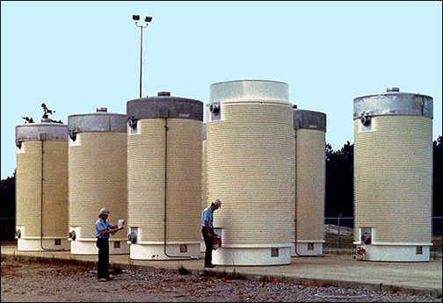
Dry casks are the next storage step.
After cooling several years in the spent fuel pool, spent fuel can be removed from the pool and stored in dry casks.
Notes:
In the late 1970s and early 1980s, the need for alternative storage began to grow when pools at many U.S. nuclear reactors began to fill up with stored spent fuel. Utilities began looking at options such as dry cask storage for increasing spent fuel storage capacity.
Dry cask storage allows spent fuel that has already been cooled in the spent fuel pool for at least one year (usually 5 to 8 years) to be surrounded by inert gas inside a container called a cask. The casks are typically steel cylinders that are either welded or bolted closed. The steel cylinder provides a leak-tight containment of the spent fuel. Each cylinder is surrounded by additional steel, concrete, or other material to provide radiation shielding to workers and members of the public. Some of the cask designs can be used for both storage and transportation.
There are various dry storage cask system designs. With some designs, the steel cylinders containing the fuel are placed vertically in a concrete vault; other designs orient the cylinders horizontally. The concrete vaults provide the radiation shielding. Other cask designs orient the steel cylinder vertically on a concrete pad at a dry cask storage site and use both metal and concrete outer cylinders for radiation shielding. The photograph above is a typical dry cask storage system.
The first dry storage installation was licensed by the NRC in 1986 at the Surry Nuclear Power Plant in Virginia.
Spent fuel is currently stored in dry cask systems at a growing number of power plant sites. See the map showing the location of existing independent spent fuel storage installations at url http://www.nrc.gov/waste/spent-fuel-storage/locations.pdf

Slide 12
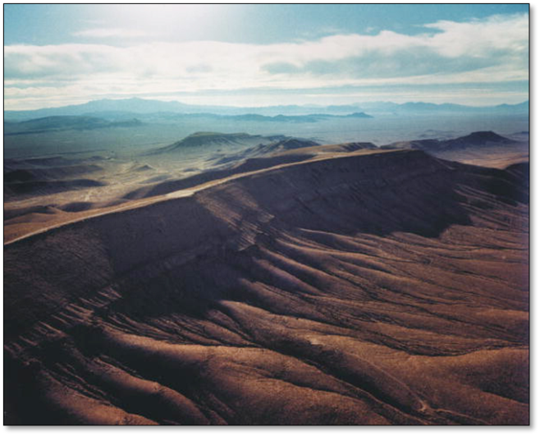
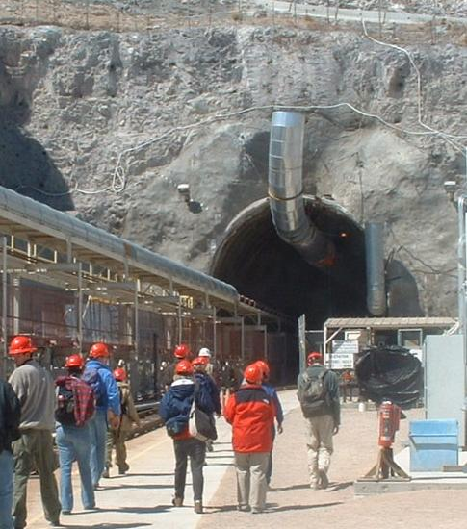
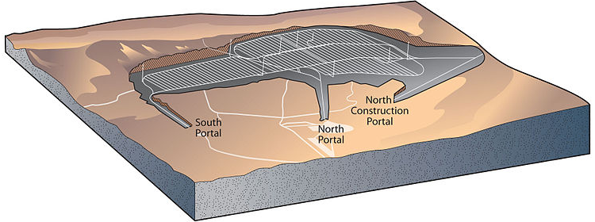
Storing spent fuel underground
High-level waste could be isolated 300 to 900 meters beneath the surface of the Earth in a geologic repository.
Yucca Mountain was investigated as a geologic repository. In 2010, work was stopped for that site.
For now, spent fuel is stored at the powerplants.
Notes:
Yucca Mountain, a site in Nevada was investigated as a site for a repository, but in 2010, the government stopped funding for that site. A Blue Ribbon Commission was named to discuss new options for nuclear waste management. In 2011, they concluded that permanent disposal is needed and that geologic disposal is the best option. They suggested finding a suitable site where the community wants to host a disposal facility.
300 to 900 meters is roughly equal to 1,000 to 3,000 feet.

Slide 13
Other options for spent fuel are on the table.
Options
“Recycled” spent fuel in steps called reprocessing. Reprocessed fuel can be used again.
Treat all spent fuel as waste and bury it deep underground.
Store the fuel at the reactors.
Challenges
Reprocessing is expensive.
Although reprocessing reduces total wastes, some high-level waste remains.
Valuable fuel will not be reused.
It must be geologically stable for thousands of years.
Some people do not want a site where they live.
Onsite storage is not permanent.
Some reactors are running out of room and will have to build more storage.
Notes:
After being stored at power plants for 10 to 20 years, spent fuel could be sent for reprocessing or dry cask storage elsewhere. Even if spent fuel is reprocessed, there will still be waste that requires permanent isolation in disposal.
If the U.S. decides to reprocess, some of what is now waste will become fuel. The decision is due by the end of 2011 or early 2012.

Slide 14
Summary: Fill in the blanks
Like all industries, nuclear power plants produce wastes. Some of the wastes are radioactive and require special methods of disposal.
The way radioactive waste is disposed of depends on:
• how radioactive the waste is
• the half-life of the waste, and
• the physical and chemical forms of the waste.
Waste that has been contaminated with radioactive material at hospitals, research labs, industry, and power plants is called low-level waste.
Most of the waste at a nuclear power plant that is radioactive is low-level waste. Usually we seal it in boxes or steel drums and bury it at licensed disposal sites.
Notes:
The answers are in the sentences above. You can turn this page into an activity using your cursor to highlight the blank spaces. Use your toolbar to make the answers’ font not white.
Review these facts with students before or after a quiz.

Slide 15
Summary (continued)
Nuclear fuel is removed from the reactor when it can no longer support fission efficiently. This spent fuel from power plants can be considered high-level waste.
Spent fuel is stored in spent fuel pools of water near the reactor. There it cools and undergoes radioactive decay.
After a year or two in the spent fuel pool, spent fuel can be removed from the pool and stored in dry casks.
Notes:
The answers are in the sentences above. You can turn this page into an activity using your cursor to highlight the blank spaces. Use your toolbar to make the answers’ font not white.
Review these facts with students before or after a quiz.

Slide 16
Summary (continued)
The United States has not made a final decision about how to permanently dispose of high-level waste.
The usable parts of spent fuel can be recycled through a process called reprocessing. But the United States is not currently reprocessing spent fuel.
Even if fuel is reprocessed, there is still waste that requires permanent isolation because it remains radioactive for thousands of years.
High-level waste left over after spent fuel reprocessing could be isolated deep beneath the Earth’s surface in a geologic repository.
Notes:
The answers are in the sentences above. You can turn this page into an activity using your cursor to highlight the blank spaces. Use your toolbar to make the answers’ font not white.
Review these facts with students before or after a quiz.

Slide 17
Summary (continued)
All of the steps involved in using nuclear energy to make electricity are called the “nuclear fuel cycle.”
These steps include
• mining
• milling
• enrichment
• fuel fabrication
• using the fuel at the power plant
• storing used fuel, and
• final disposal of waste that will remain radioactive for thousands of years.
Notes:
The answers are in the sentences above. You can turn this page into an activity using your cursor to highlight the blank spaces. Use your toolbar to make the answers’ font not white.
Review these facts with students before or after a quiz.

Slide 18

Advanced Student Assignment
A debate is a discussion in which participants state their positions on a topic.
Select a topic
Should spent fuel be stored in an underground repository? or
Should the United States reprocess spent fuel?
Take a stand
Decide who’s pro and who’s con? Every debate has two sides: the positive side and the negative side. The positive side is “pro.” Pro supports an idea. The negative side is “con.” Con opposes the idea. Students may choose their own side or your teacher can divide the class into pros and cons.
Notes:
Allow one to three class periods for this activity.
Distribute sheets of paper or index cards. On the front side, students write either PRO or CON in large, bold letters. Raising the card will indicate the student’s request to speak. Ask students to track their participation by making a fold in the corner of the card every time they speak. To give everyone a chance to speak, after three folds, students should not raise their cards until all students have voiced their opinions. (Tell students to keep the cards. The backs will be used after the debate.)
The format of this activity is adapted from LEARN NC (Pamela Myrick and Sharon Pearson) at http://www.learnnc.org/lp/pages/636

Slide 19
Advanced Student Assignment (cont’d)
Gather your facts.
Support your stance with facts and use this framework to support them.
Stand: We believe the U.S. should have underground repositories for spent fuel.
Source 1:
Fact:
Source 2:
Fact:
Source 3:
Fact:
Notes:
Each student should have his own fact gathering table that supports his point of view. The Harnessed Atom student book should be one of a minimum of three sources.

Slide 20
Advanced Student Assignment (cont’d)
Start the debate.
The moderator (teacher or a student) formally introduces the debate topic and calls on students to speak. He alternates between pro and con speakers.
Opening and closing statements
Appoint one student in each stance to make opening and closing statements. The pro side begins the debate with an opening statement. Then the con side makes a statement. Opening statements should include each side’s opinion with a brief overview of the supporting evidence.
The debate ends with closing statements from pros and cons. Again the pro side speaks first and is followed by the con side. The planned closing statements (one to three minutes) should restate the opinions and evidence.
Review and evaluate.
Vote for the most persuasive statement.
Notes:
Debate do’s
As we all know, students need expectations spelled out. We suggest that these Debate Do’s be posted in the classroom and referenced often:
• Be polite and courteous.
• Listen attentively
• Be respectful and supportive of peers.
• Do not make inappropriate noises.
• Speak only when recognized by the moderator.
• Allow others to express their opinions; do not monopolize the debate.
• Use grammatically correct language.
• Speak clearly, slowly, and loudly enough to be heard by the audience.
• Speak with passion and excitement.
Review and evaluate: Ask students to vote for the most persuasive stance on the back sides of their cards. Ask them to give two reasons for their vote. Ask if the facts and sources given? Did everyone have a corner bent in their card? Do debaters follow the Debate Dos?

Slide 21
Lesson 7 Vocabulary
by-product – something produced in an industrial process in addition to the main, wanted product; sometimes an unexpected or unintended result
compact – a legal agreement between two or more parties
decommission – the process of closing a nuclear power plant after it has outlived its usefulness
dismantle – to take apart; to break into pieces
dry cask storage – a method for storing spent fuel at a nuclear power plant in steel cylinders that are surrounded by more steel, concrete, or other material to provide radiation shielding
geologic repository – a facility for disposal of high-level nuclear waste and spend fuel located deep beneath the surface of the Earth in a stable geologic environment

Slide 22
Vocabulary
high-level radioactive waste – nuclear power plant waste that is very radioactive; examples include spent fuel or the waste left from reprocessing spent fuel to recover usable materials
low-level radioactive waste –items that have been contaminated with radioactive material; examples include used protective clothing, broken tools, gloves, cleaning rags, and filters
low-level waste compact – a legal agreement by States for the disposal of low-level radioactive wastes generated with the borders of member States
nuclear fuel cycle – all the steps, from mining to disposal, involved in using nuclear energy to generate electricity
plutonium– a naturally radioactive, silvery, metal whose atoms can be split when bombarded with neutrons; found in small quantities in uranium ores but is usually man-made in nuclear reactors; used as reactor fuel; symbol is Pu

Slide 23
Vocabulary
reprocessing – extraction of uranium and plutonium from spent fuel rods for reuse as fuel
spent fuel – uranium fuel that has been used and then removed from the reactor; a form of high-level radioactive waste
spent fuel pool – a deep pool of water in a building near the reactor where spent fuel from a nuclear power plant is stored while it cools and undergoes radioactive decay
waste – unwanted byproducts

Slide 24
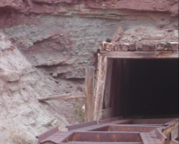
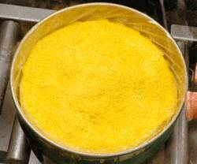
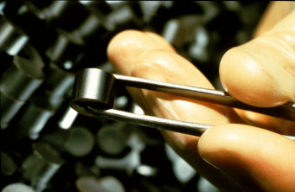
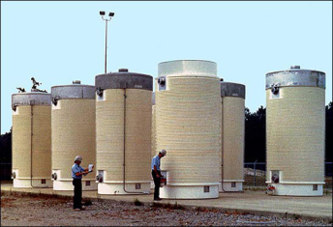
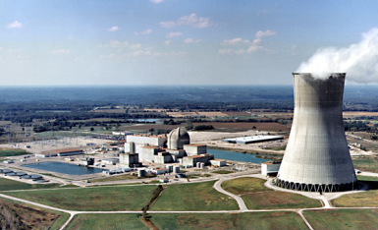
For Discussion: Nuclear fuel cycle
All the steps from mining uranium to getting it to power plants to disposing of waste are part of the nuclear fuel cycle.
Mining Milling, Processing, Enrichment, and Fabrication
Disposal Power Production
Notes:
The nuclear fuel cycle is the progression of nuclear fuel through a series of differing stages. It consists of steps in the front end, which are the preparation of the fuel, steps in the service period in which the fuel is used during power production, and steps in the back end, which are necessary to safely manage, contain, and either reprocess or dispose of spent nuclear fuel. If spent fuel is not reprocessed, the fuel cycle is referred to as an open fuel cycle (or a once-through fuel cycle); if the spent fuel is reprocessed, it is referred to as a closed fuel cycle. Reprocessed spent fuel is high-level radioactive waste.
Pictured above is an open fuel cycle. The disposal photo is a spent nuclear fuel shipping cask mounted on a railroad car.
Ask Students: Is this really a “cycle”? (Answer: Without reprocessing, the spent fuel is not reusable. Therefore, it is not really a cycle. Discussion could identify other recycled resources that students know, such as paper, glass, and aluminum.)

